Slide 1
SQL Joins
Instructor: Kazi Amit Hasan

Slide 2
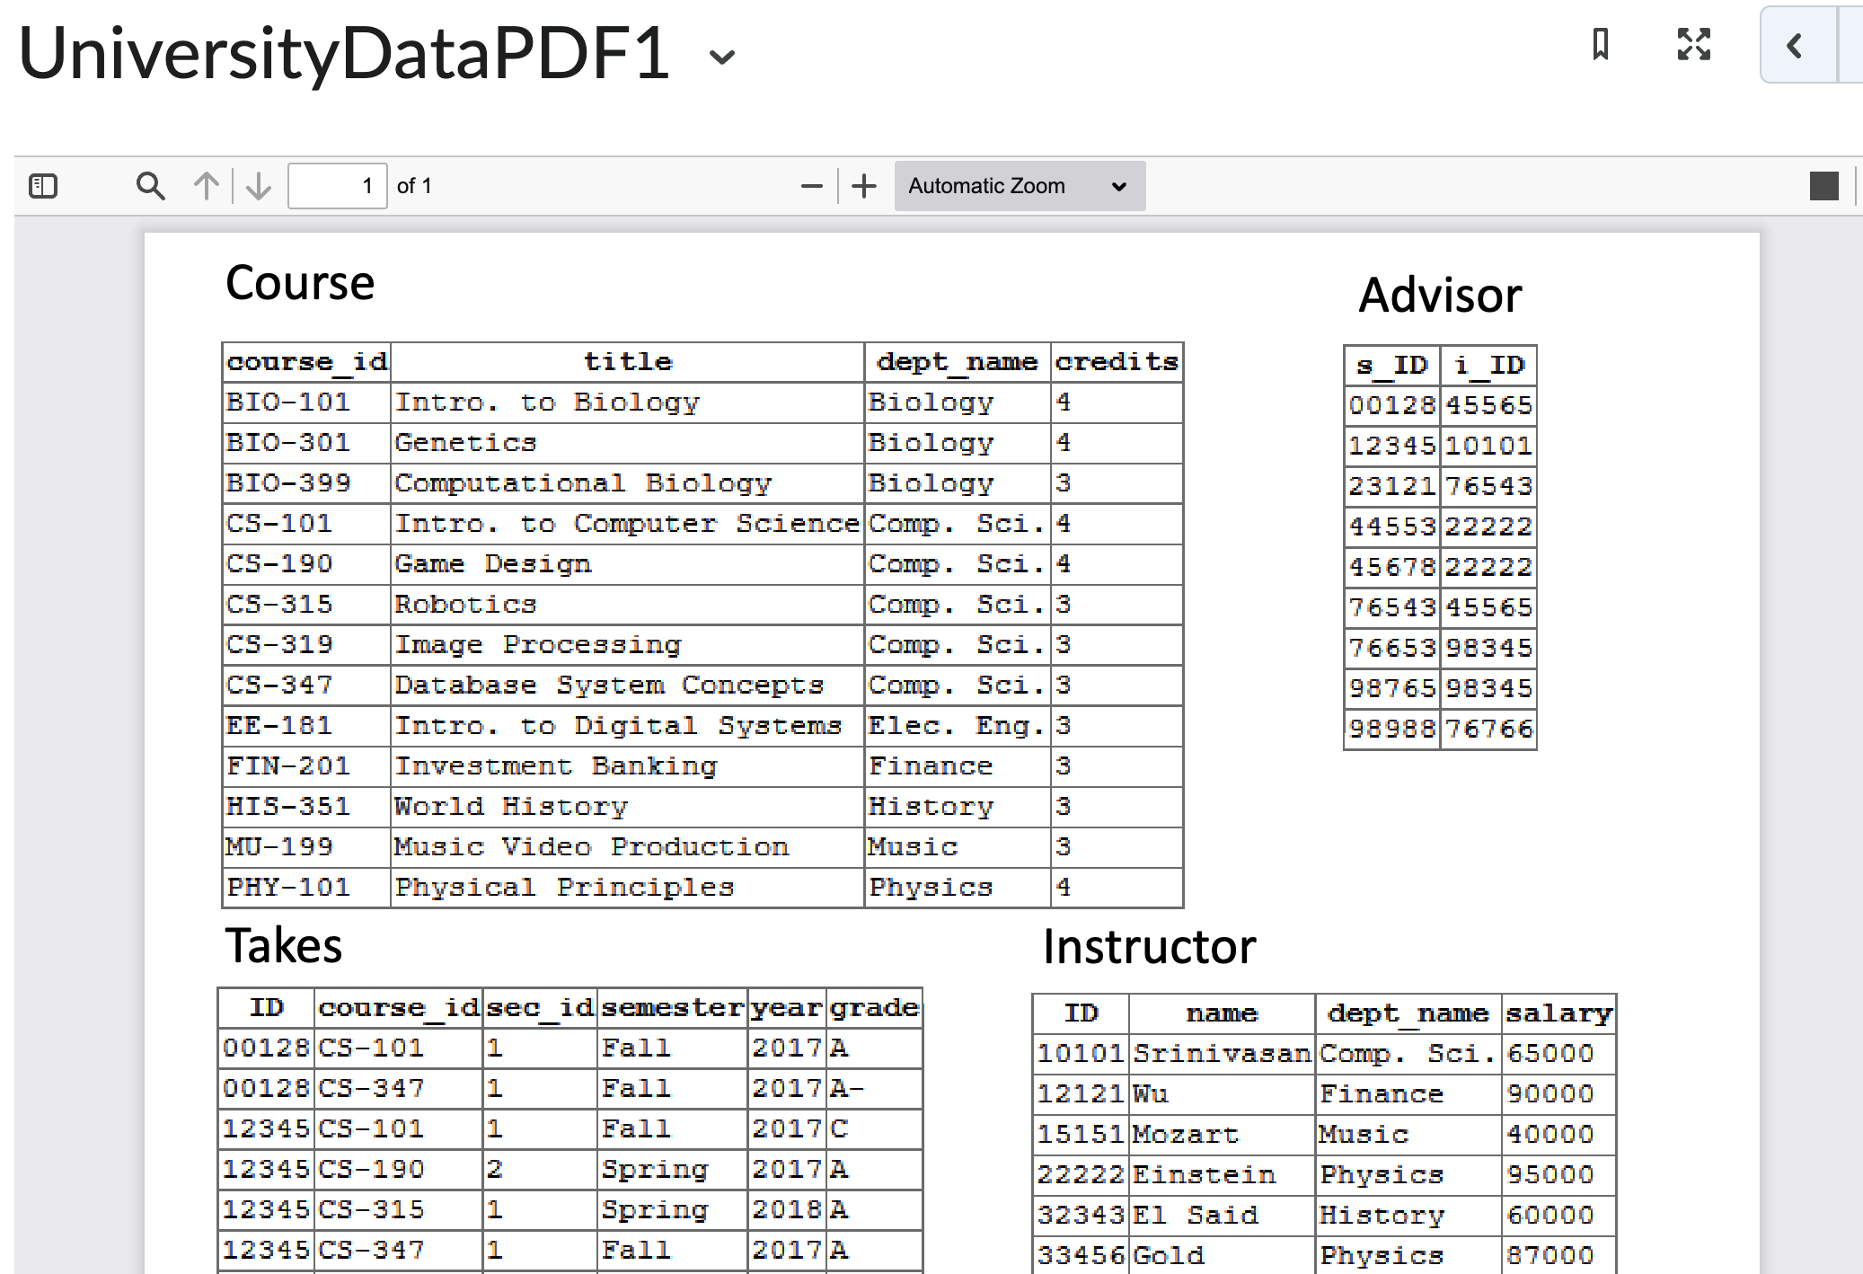
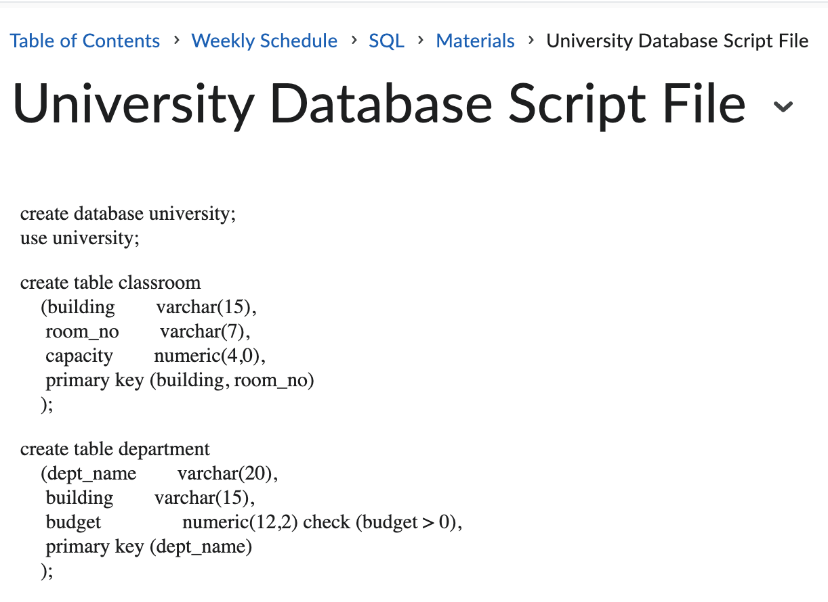
You must try these!

Slide 3


From clause
The from clause lists the relations involved in the query

Slide 4


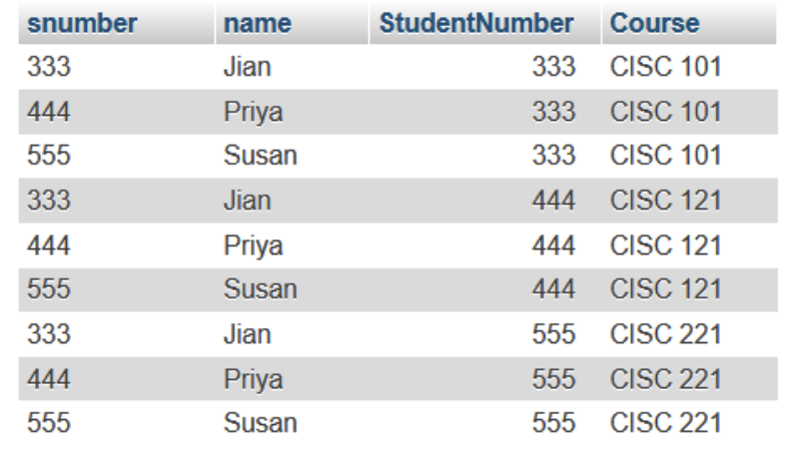

Slide 5


Surprisingly ....

Slide 7

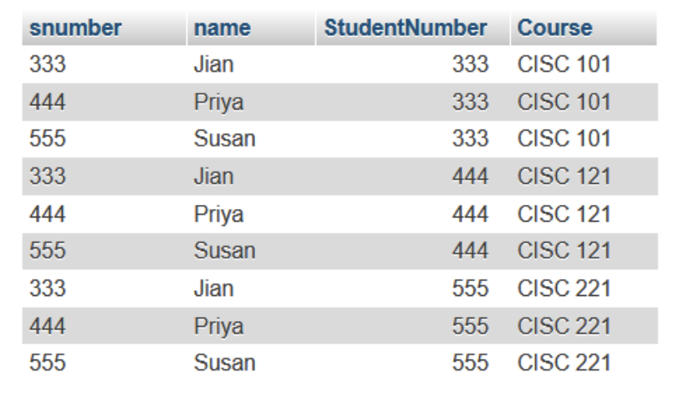


Slide 8
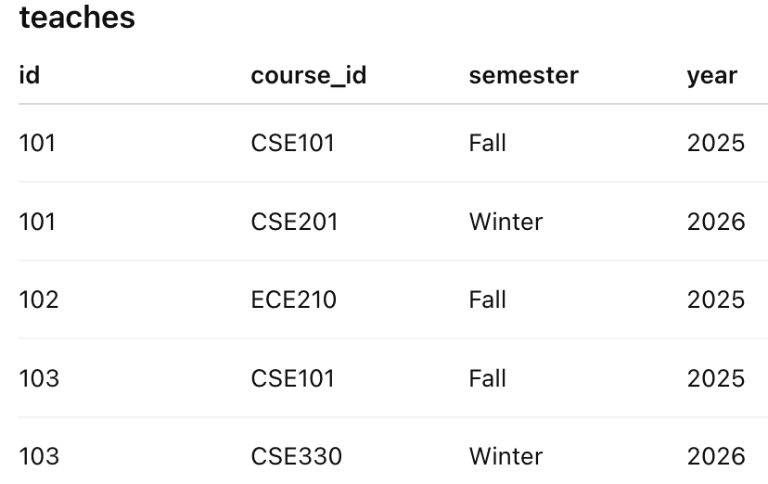
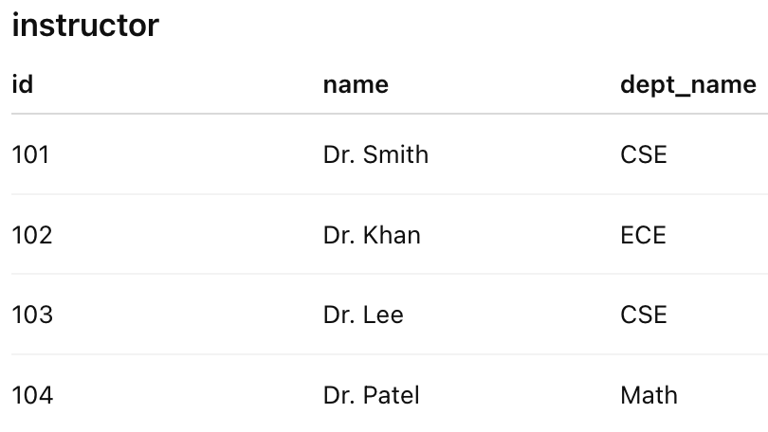
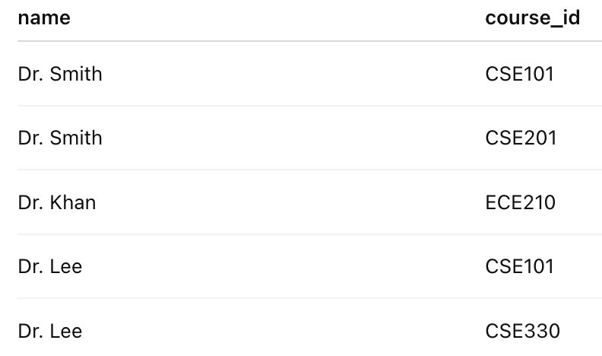
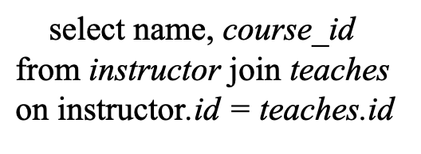
Joins
Find the name of the instructor and the course_id of all courses they teach

Slide 9


Natural Join
List the names of instructors along with the course ID of the courses that they taught

Slide 10
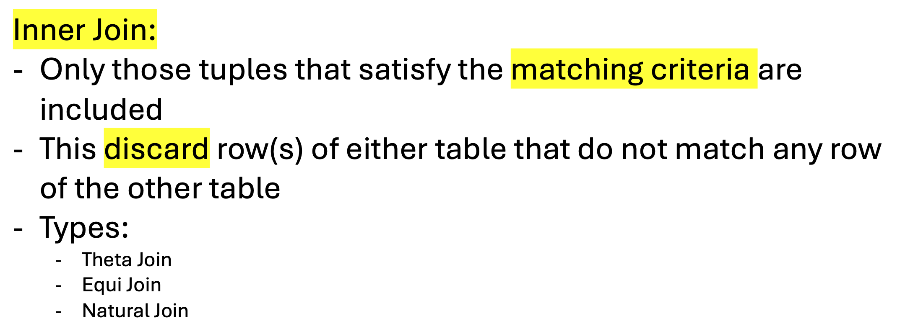
Inner Join

Slide 11


Find the course ID, semester, year and title of each course offered by the computer science department

Slide 12

Same Query
Find the course ID, semester, year and title of each course offered by the computer science department

Slide 13
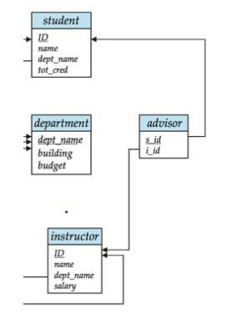

Multiple Joins
Find names of students and their advisor names

Slide 14
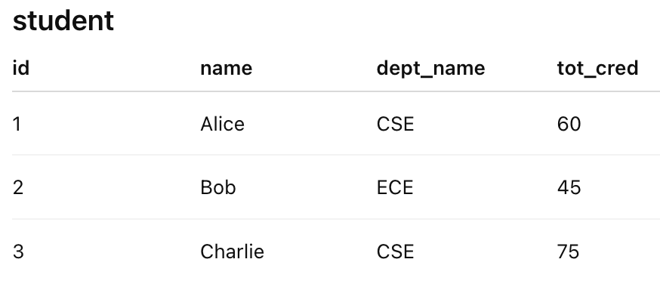
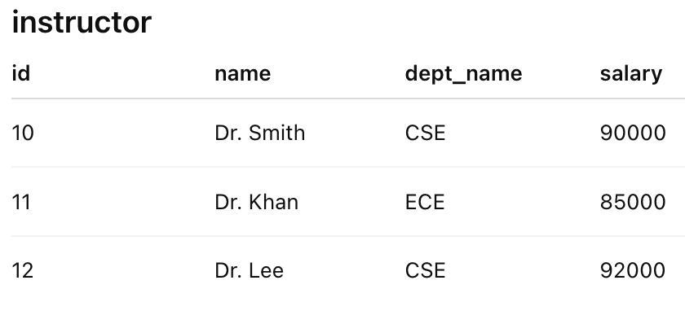
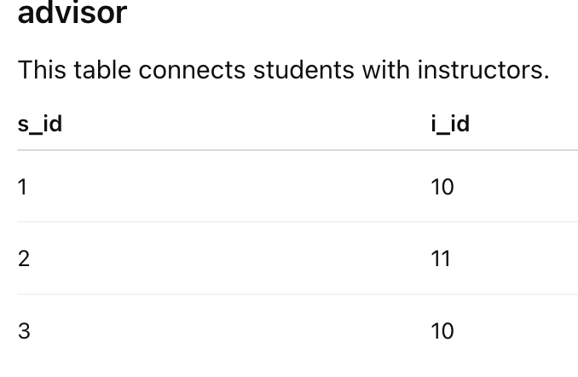
Find names of students and their advisor names

Slide 15

Find names of students and their advisor names

Slide 16

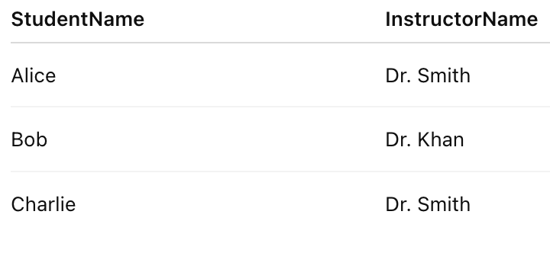
Find names of students and their advisor names

Slide 17
Outer Join

Slide 18

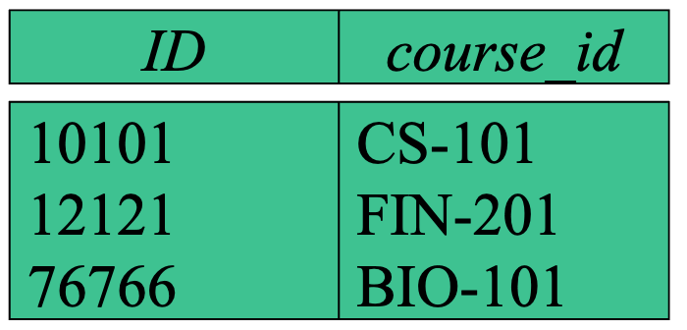



Perform natural join

Slide 19


Slide 20


Slide 21
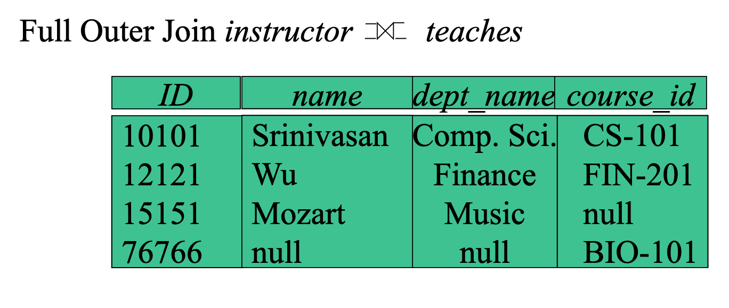

Slide 22
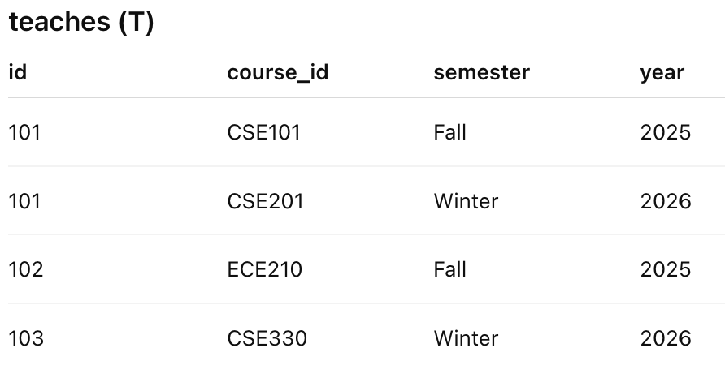
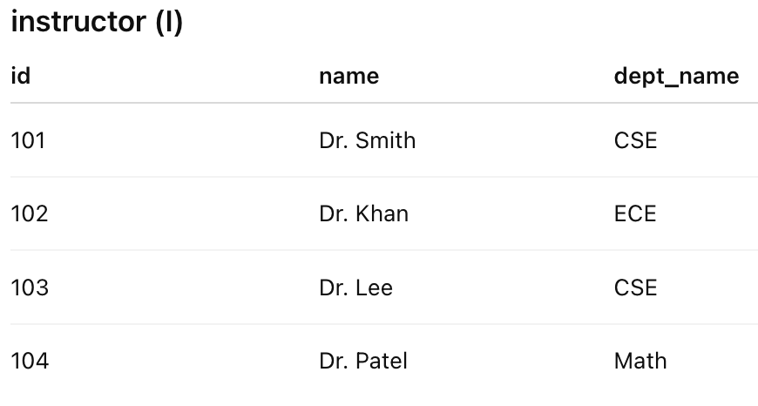
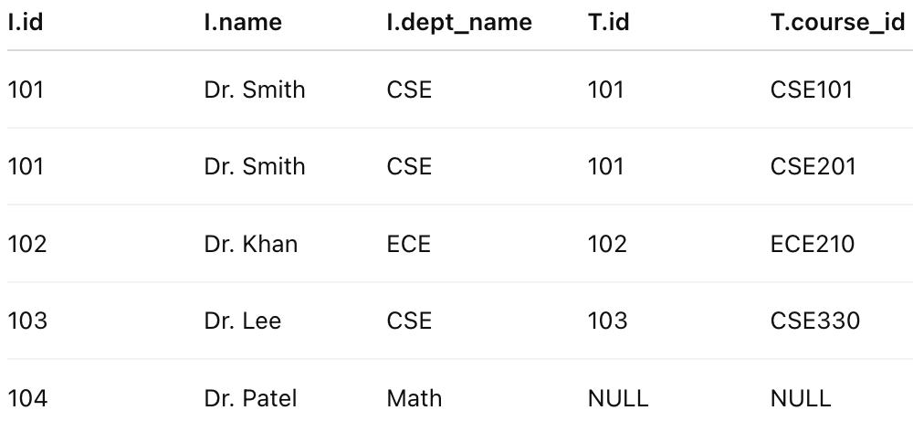
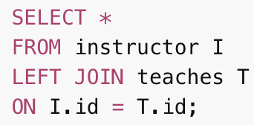
Left Outer Join
List all instructors and the courses they teach, if any

Slide 23
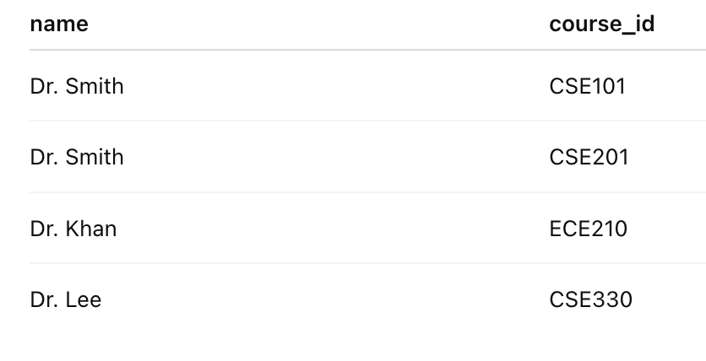
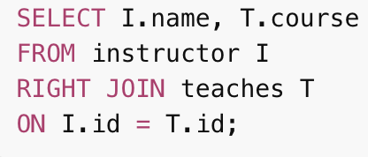
Right Outer Join
List all courses and the instructors who teach them, if any

Slide 24
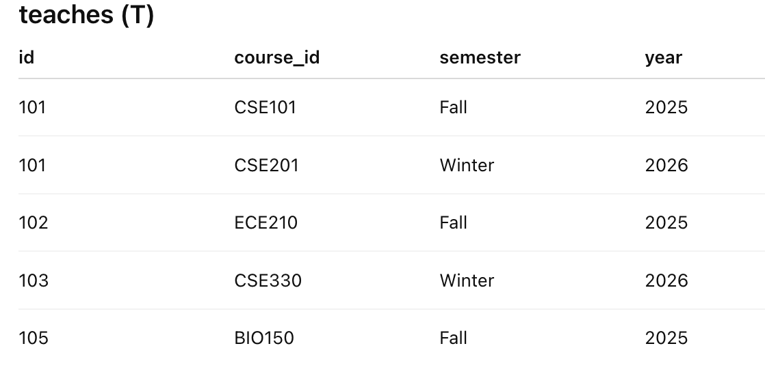
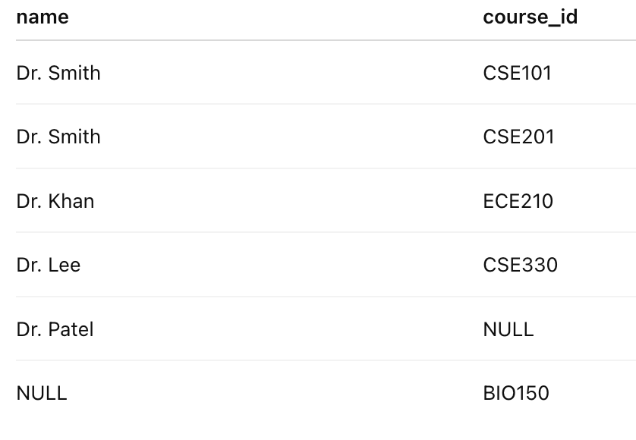
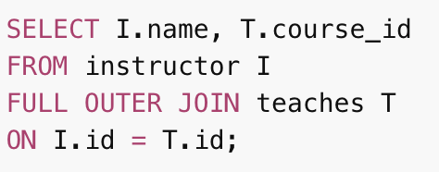
Full Outer Join
List all instructors and all courses, showing who teaches what when possible

